Slide 1
Section 12.5
Partial Fraction Decomposition
Copyright © 2012 Pearson Education, Inc. Publishing as Prentice Hall.

Slide 2
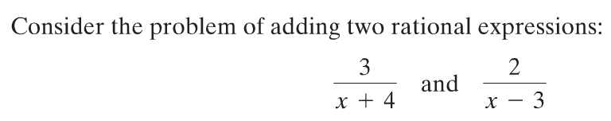
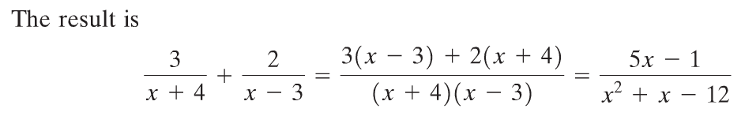

Copyright © 2012 Pearson Education, Inc. Publishing as Prentice Hall.

Slide 3

Copyright © 2012 Pearson Education, Inc. Publishing as Prentice Hall.

Slide 4
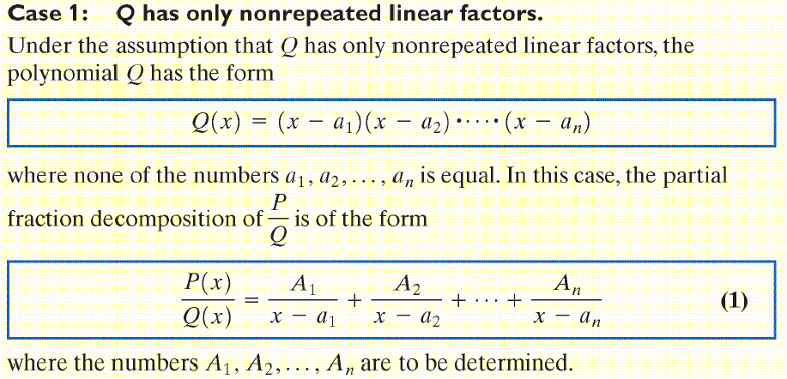
Copyright © 2012 Pearson Education, Inc. Publishing as Prentice Hall.

Slide 5

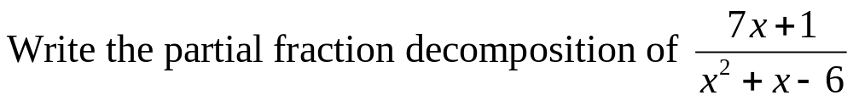
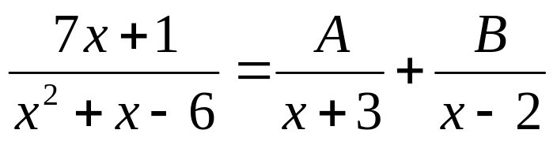

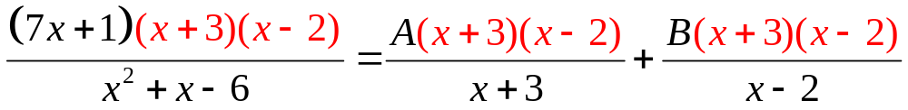


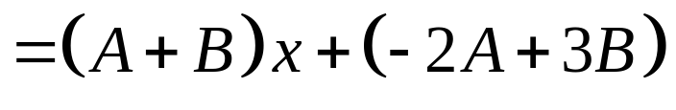
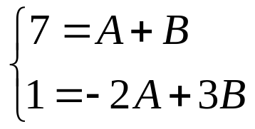

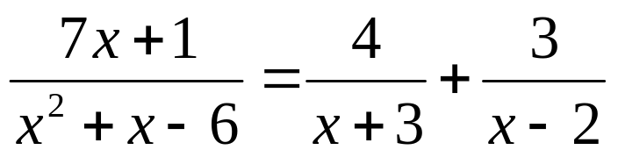
Equate coefficients of like powers of x to get:
Copyright © 2012 Pearson Education, Inc. Publishing as Prentice Hall.

Slide 6

Copyright © 2012 Pearson Education, Inc. Publishing as Prentice Hall.

Slide 7
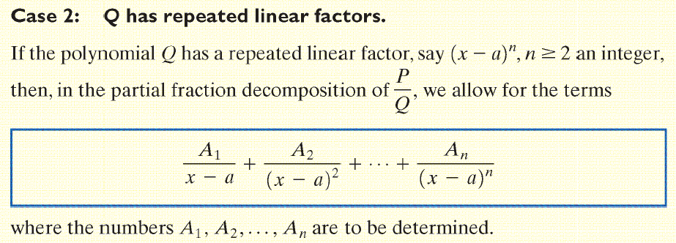
Copyright © 2012 Pearson Education, Inc. Publishing as Prentice Hall.

Slide 8

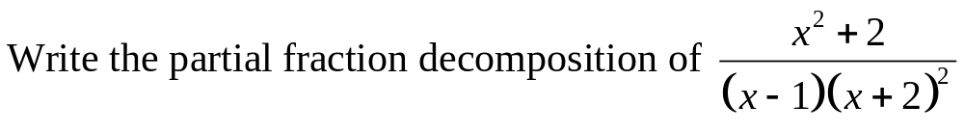
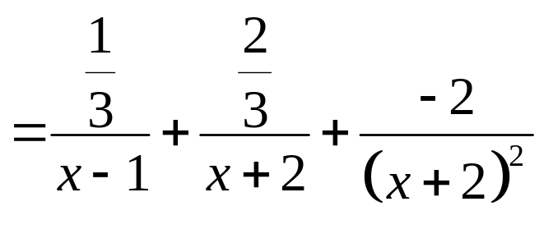
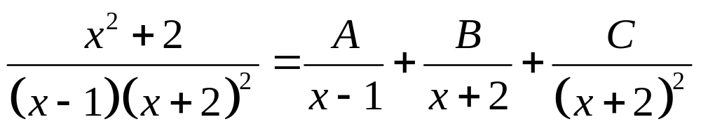
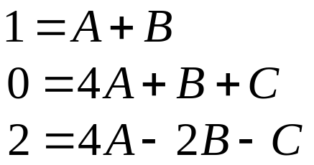
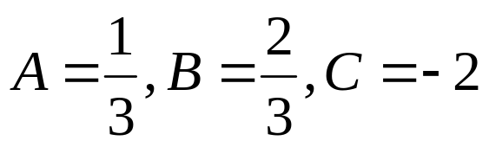
Copyright © 2012 Pearson Education, Inc. Publishing as Prentice Hall.

Slide 9
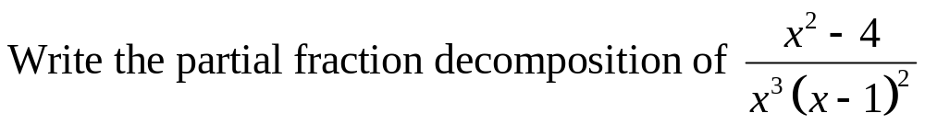
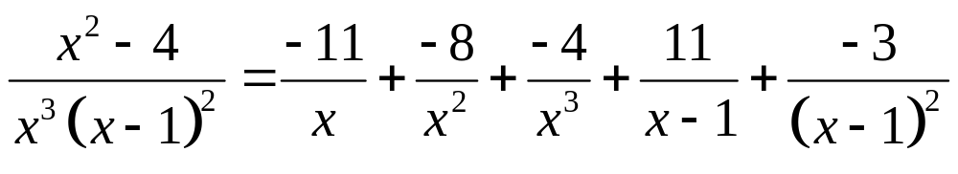
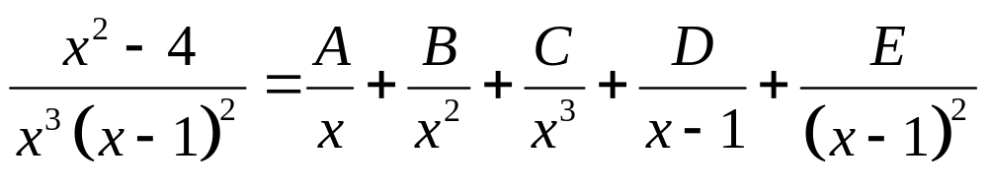
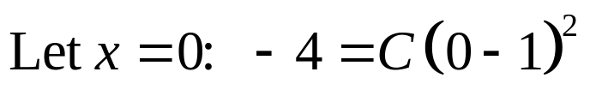
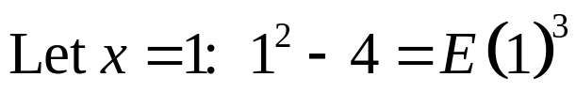


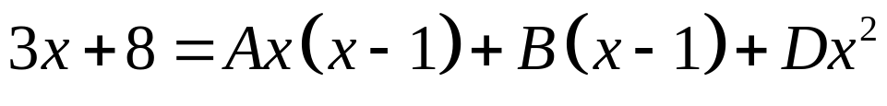
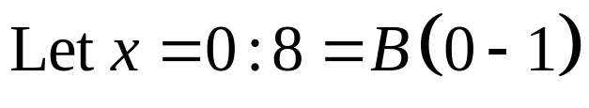

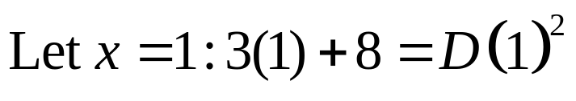

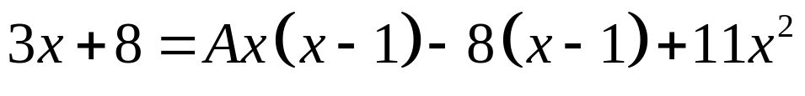

Copyright © 2012 Pearson Education, Inc. Publishing as Prentice Hall.

Slide 10

Copyright © 2012 Pearson Education, Inc. Publishing as Prentice Hall.

Slide 11
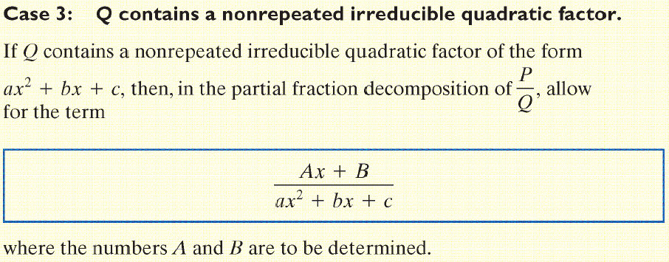
Copyright © 2012 Pearson Education, Inc. Publishing as Prentice Hall.

Slide 12
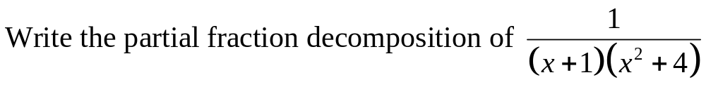
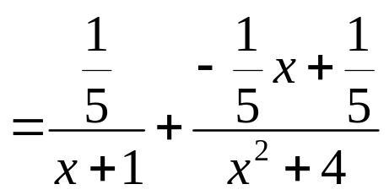
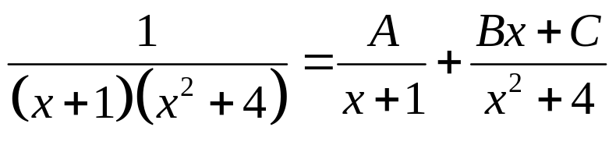
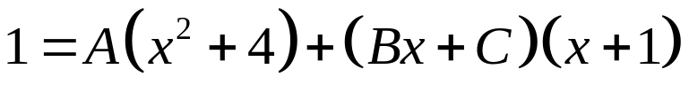
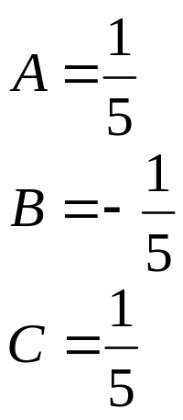
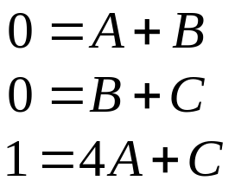

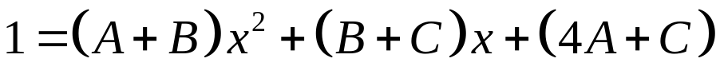
Copyright © 2012 Pearson Education, Inc. Publishing as Prentice Hall.

Slide 13
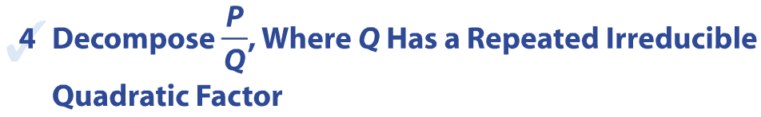
Copyright © 2012 Pearson Education, Inc. Publishing as Prentice Hall.

Slide 14
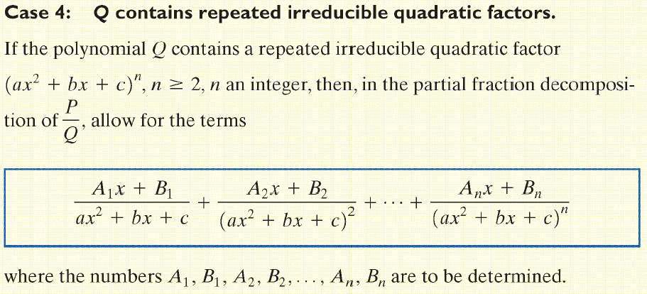
Copyright © 2012 Pearson Education, Inc. Publishing as Prentice Hall.

Slide 15
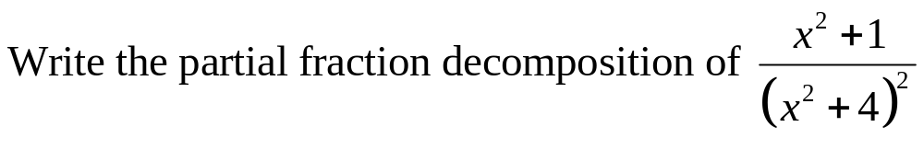
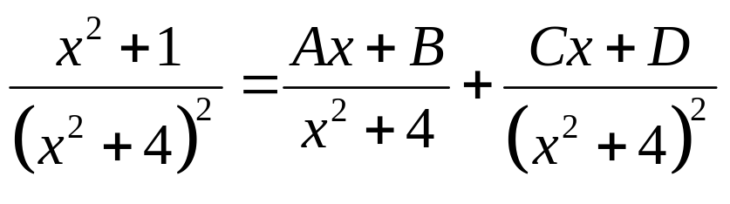
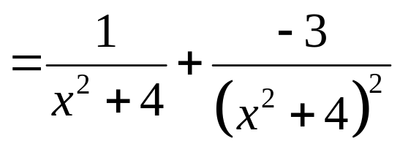
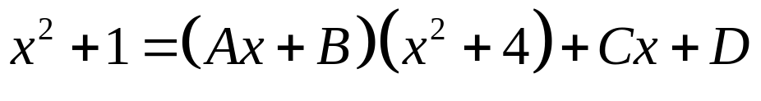
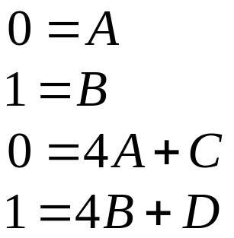
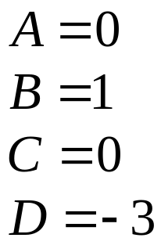
Copyright © 2012 Pearson Education, Inc. Publishing as Prentice Hall.

